Slide 1
Practising cyber safety
Aaditya purani

Slide 2
THE MASTER PLAN
Who are these bad guys ?
Why do they want to target you ?
How they can target you ?
What you should do to safeguard yourself ?

Slide 3

Know the players of the dark game
Pic-credit: Unsplash
Identifying Threat Actors

Slide 4

Scammers
Information Gathering / Reconnaissance
Attempt to Trick into making Online Payments
Installing Remote Access Tool
Credit: ESB Professional/Shutterstock
Credit card theft
Works on the Surface/deep web
Also technically called ‘Social Engineering’

Slide 5
How do they gather my information?
From your Public Posts on Forums, Craigslist, Social Networking website
Geo-Location Leak ( Snapchat, Instagram Location, Swarm-app )
Personal Contact Information placed online
Third Party Data Selling / Data-Theft
Registering on a sketchy website

Slide 6

Black Hat Hackers
Technically Proficient
May use Social Engineering
Develop their own toolset for carrying attack
Goal is either to make money or to make Botnet stronger
Credit: Digital Dot
They work anonymously on Dark Web

Slide 7

Phishing attacks
Pic-credit: ZDNet
Convincing you to CLICK !

Slide 8

Identifying attacks
Pic-credit: TestSphere
The only winning move is not to play

Slide 9
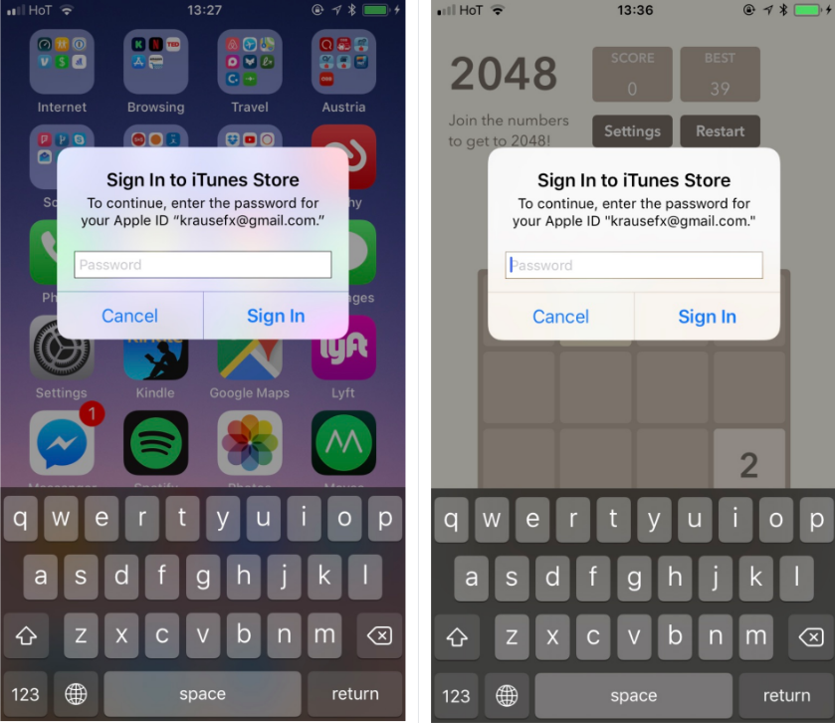

Slide 10
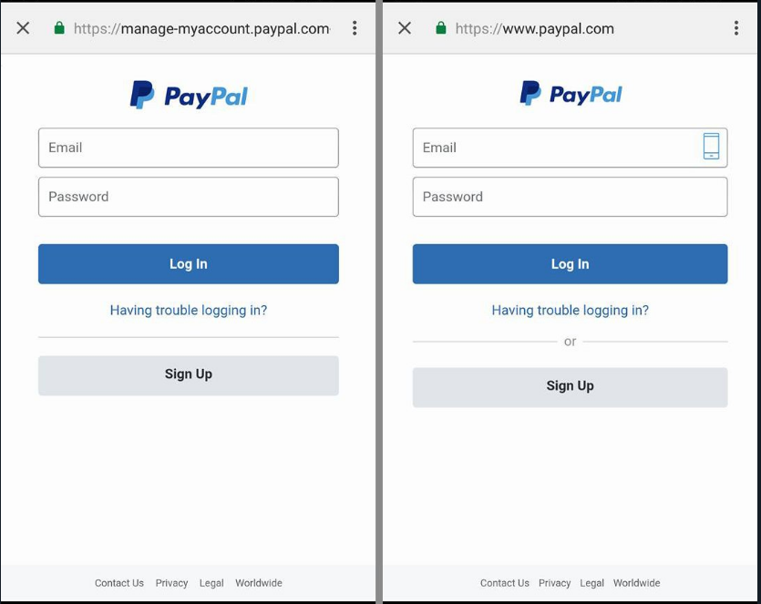

Slide 11
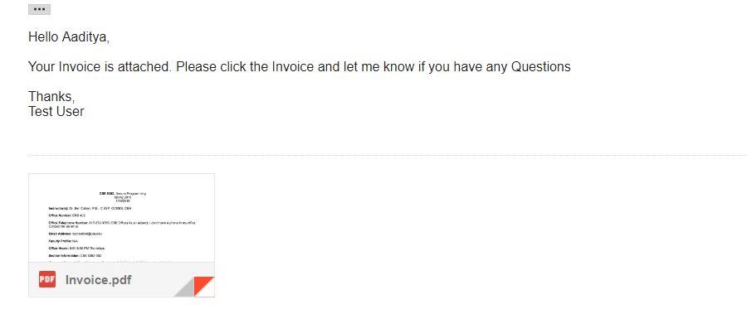
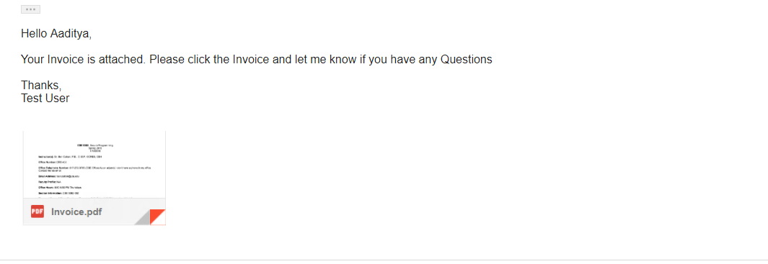

Slide 12
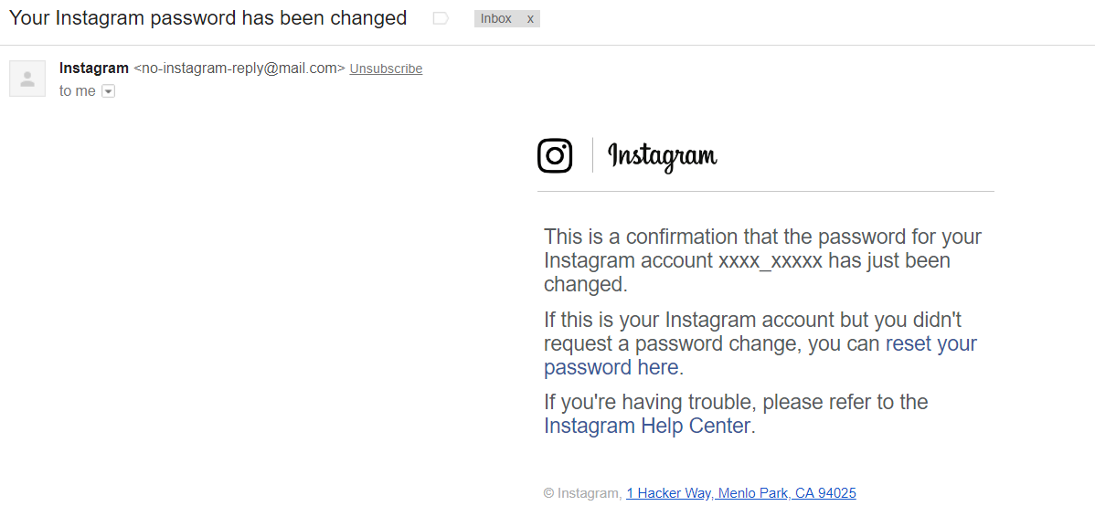
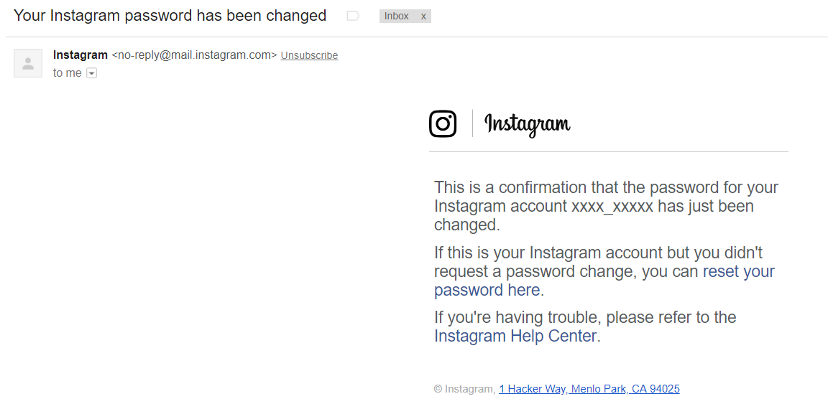

Slide 13
Solutions
Challenge 1: The Image 2 is Phishing Pop-Up
Using UIAlertController from iOS application
Challenge 2 : The Image 1 is Phishing URL
Look closely at URL
What you see is not always true. It’s a Subdomain like manage-myaccount.paypal.com.evil.com
Challenge 3 : The Image 2 is Phishing Redirection
Abusing Gmail’s attachment logic
Pic 2 isn’t actually a PDF but a Image which looks like PDF and attached Inline with hyperlink to http://
Challenge 4 : The Image 1 is Phishing Page
Look closely at e-mail address it has Instagram-no-reply@mail.com , mail.com not equals Instagram.com

Slide 14

Domino effect
Pic-credit: edie.net
It starts with one

Slide 15

Securing yourself
Pic-credit: BleepingComputer
Time to Implement

Slide 16
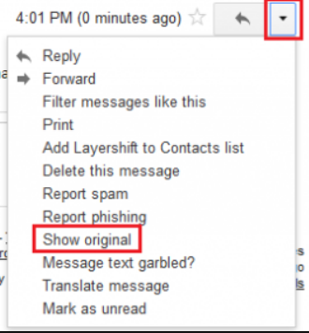
View Originating source/ Headers of the Mail / Message
Think Before you Click
Nothing Ever goes away once you put it on Internet
Check twice before installing over-permissive app
Inspect the Hyperlink before redirecting to any page
Install Anti-Virus + Anti-Adware (Up2date)
Do not fall for luring message / calls (Jackpots, Loans etc)
Don’t ever enter your password on random sites
1Password is much better (Passphrase utility tool) – Beats keylogger
Don’t feed the Hackers (Don’t pay ransom)
Rotate your password frequently and use different pw for different sites

Slide 17
q/a?

